Slide 1
Fire Grant Programs
September 2024
Assistance to Firefighter Grant (AFG) Program
Staffing for Adequate Fire and Emergency Response (SAFER) Grant Program
Fire Prevention and Safety (FP&S) Grant Program
Notes:
Greet people and introduce yourself.
Thank you for the opportunity to tell you about the fire grant programs.

Slide 2



Fire Grants: AFG, SAFER, FP&S
Assistance to Firefighters Grant Program (AFG) – Provides funding for fire and EMS equipment, PPE, Training, Wellness and Fitness activities, Modification to Facility projects, and Vehicles.
Staffing for Adequate Fire and Emergency Response (SAFER) – Provides funding to fire departments to increase staffing to meet national standards either through hiring full-time operational firefighters or the recruitment and retention of volunteers.
Fire Prevention and Safety (FP&S) – Provides funding for fire prevention education and training; wildfire risk reduction; fire code enforcement; fire/arson investigation, and research and development on firefighter health, safety, and well-being.
Notes:
The fire grants consist of three separate programs.
All three programs will have their own guidance documentation and application periods. It is possible to apply for all 3 programs in same year and receive funding.
The Assistance to Firefighters Grant Program – Provides funds for fire and EMS equipment, PPE, Training, Wellness and Fitness activities, Modification to Facility projects, and Vehicles.
Staffing for Adequate Fire and Emergency Response – Provides funding to fire departments to increase staffing to meet national standards either through hiring full-time operational firefighters or the recruitment and retention of volunteers.
Fire Prevention and Safety – Provides funding for:
fire prevention education and training,
wildfire risk reduction
fire code enforcement
fire/arson investigation
and research and development on firefighter health, safety, and well-being.

Slide 3


FY 2024 Fire Grants Funding
$ 291,600,000
$ 324,000,000
$ 32,400,000
Notes:
For FY 2024 congress appropriated $648 million for all three programs. That is a reduction from $720 million the program had for FY 2023.

Slide 4
Application and Award Process
NOFO
Application Period
Electronic Scoring
Peer Review Panel
Technical Review
Awards
Fire Grants Website: https://www.fema.gov/firegrants
Application Portal: https://go.fema.gov/
Notes:
We plan is to open AFG application period this fall, followed up by SAFER and FP&S programs.
The typical application process begins with the release of the Notice Of Funding Opportunity that will be posted on our website.
The application period is typically open for 30 days. All applications must be submitted via FEMA GO Portal.
Once applications are submitted: AFG and SAFER applications are subject to the electronic scoring where a computer compares various criteria, weighted questions and program priorities to the request. Important to note here is that FP&S applications DO NOT undergo an electronic pre-score, they skip this step and go to Peer Review Panel.
AFG and SAFER applications that score well enough through the electronic score process will move on to the Peer Review where members of the fire service will read and score the applications.
For AFG and SAFER, the computer score will be averaged with the peer panel review score, which will provide the application’s final score.
All applications in the fundable range will undergo technical review by FEMA staff and SME to ensure that the items are eligible, and the costs are reasonable and that the recipient is in good standing.
Awards will be made based on score ranking from the highest until we run out of money.

Slide 5
Notice of Funding Opportunity (NOFO)
NOFO
  Program Objectives and Priorities
  Applicant Eligibility
  Cost Share Requirements
  Activity and Item Eligibility
  Application Requirements
  Review Process
H
High Priority
M
Medium Priority
L
Low Priority
Notes:
AS I mentioned earlier, each program has its own notice of funding opportunity or NOFO. This document provides a multitude of important information. Such as:
Eligibility (who is eligible and who is not).
Programmatic priorities, specifically what items are considered H or Medium or Low priority
Cost share requirements
Application process and review process instructions
And various other important information that all applicants should be aware of.

Slide 6
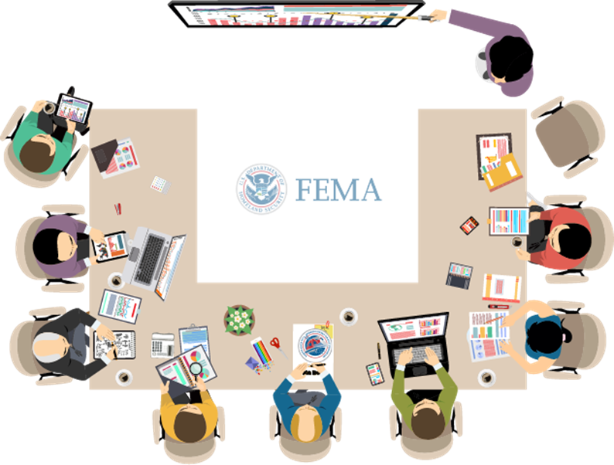
Criteria Development Panel (CDP)
International Association of Fire Chiefs
International Association of Fire Fighters
National Volunteer Fire Council
National Association of State Fire Marshals
North American Fire Training Directors
National Fire Protection Association
Congressional Fire Service Institute
International Association of Arson Investigators
International Society of Fire Service Instructors
Notes:
Speaking of priorities,
Funding priorities and criteria for all three programs is established by FEMA based on the recommendations from the Criteria Development Panel (CDP).
Each year, FEMA meets with the 9 fire service organizations that you see on the slide to review program priorities.
In addition, these 9 organizations and a few others (below) are responsible for providing peer reviewers for application reviews.

Slide 7
Where to Start

Slide 8

Technical Assistance Tools at www.fema.gov/firegrants
Review available tools:
  Notices of Funding Opportunity
  Frequently Asked Questions
  Application Checklists
  Self-Evaluation Sheets
  Narrative Development Toolkit
Participate in the workshops
  Schedules are available on our website
Notes:
We have a variety of helpful guidance tools located on our website. Please make sure to review them if you are interested in applying.

Slide 9

Top 10 Best Practices
Start preparing now
Use the application checklist to gather as much information as possible in advance
Align your department’s risk assessment with the high funding priorities
Tell your department’s unique story – avoid vendor/ template/copying other organizations’ narratives
Read each question carefully, then answer
Notes:
Top 10 best practices.
Start preparing now
Use the application checklist to gather as much information as possible in advance
Align your department’s risk assessment with the high funding priorities
Tell your department’s unique story – avoid vendor/ template/copying other organizations’ narratives
Read each question carefully, then answer

Slide 10
Top 10 Best Practices
Have your entire application/narratives reviewed by someone else before submitting
Make sure you gather and include all eligible costs as part of your application
Make sure your project can be completed within the grant’s period of performance
Ensure you have support from your local government leaders
Print your application (CTRL/CMD-P) before submitting to review for accuracy
Notes:
Have your entire application/narratives reviewed by someone else before submitting
Make sure you gather and include all eligible costs as part of your application
Make sure your project can be completed within the grant’s period of performance
Ensure you have support from your local government leaders (there is a required cost-share under AFG)
Print your application (CTRL/CMD-P) before submitting and read it over again

Slide 11
Assistance to Firefighters Grant (AFG) Program
Notes:
This section of the presentation will focus on the AFG program.

Slide 12
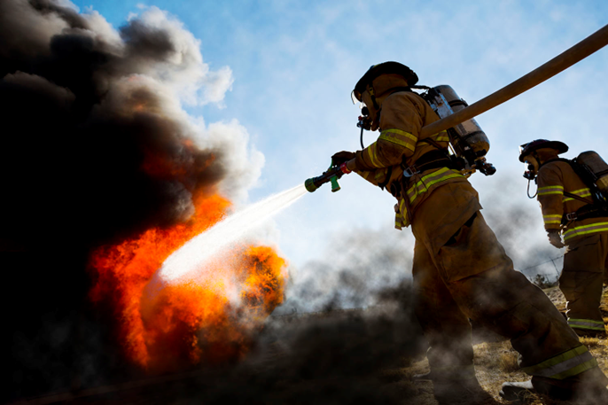
The purpose of the AFG Program is to enhance safety of firefighters and therefore public with respect to fire and fire-related hazards by providing critically needed resources that equip and train emergency personnel, outfit responders with compliant personal protective equipment, retrofit or modify facilities to protect personnel from known health hazards, acquire emergency response vehicles, design and implement health and wellness programs that enhance operational efficiencies, foster interoperability, and support community resilience.
Notes:
The purpose of the AFG Grant Program is to enhance safety of firefighters by providing critically needed resources that
equip and train emergency personnel
outfit responders with compliant personal protective equipment
retrofit or modify facilities to protect personnel from known health hazards
acquire emergency response vehicles
design and implement health and wellness programs that enhance operational efficiencies
foster interoperability
support community resilience.

Slide 13
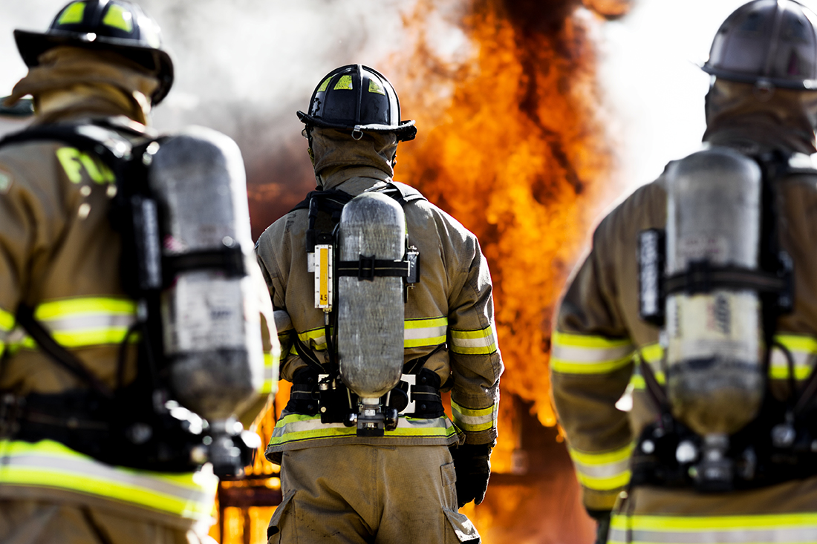

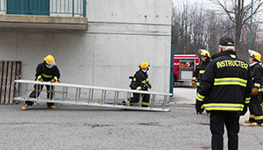
AFG Program Eligible Applicants
Fire
Departments
Nonaffiliated EMS
Organizations
State Fire
Training Academies
Notes:
Eligible applicants under the assistance to firefighters grant program are:
Fire Departments that are formally recognized to provide fire suppression to a population within a geographically fixed primary first due response area.
Non-affiliated EMS organizations that are not affiliated with a hospital or a fire department. They may be public or non-profit emergency medical service providing medical transport to a population/geographical area in which emergency medical services are not adequately provided by a fire department.
Formally recognized State Fire Training Academies.
The complete definition of what is considered a Fire Department, a NAEMS or SFTA are available in the Notice of Funding Opportunity.

Slide 14
FY 2024 AFG Funding Allocations
Allocation Requirement (by % of available grant funds) after 10% is given to Fire Prevention and Safety Grant:
  Not less than 25% to Career fire departments
  Not less than 25% to Volunteer fire departments
  Not less than 25% to Combination fire departments
  Not less than 10% to open competition among Career, Volunteer, and Combination
  Not more than 3% of available grant funds go to SFTA recipients
  Not more than 2% of available funds go to NAEMS
Notes:
The AFG program is designed around the equitable distribution of funds between department types.
After 10% of the funds are given to fund fire prevention and safety grant, not less than 25% of the funds are set aside for each of the three fire department types (career, combination and volunteer). After that there is not less than 10% that is left for open competition between the three department types.
Not more than 3% of available grant funds go to SFTA recipients.
Not more than 2% of available funds go to NAEMS.
AFG Funding Total is $291,600,000.00
Nonaffiliated EMS Organizations 2% $6.4 mil
State Fire Training Academy 3% $9.7 mil
Career Departments 25% $81 mil
Volunteer Departments 25% $81 mil
Combination Departments 25% $81 mil
Competitive 10% (+Career +Vol + Combo) 10% $32.4 mil

Slide 15
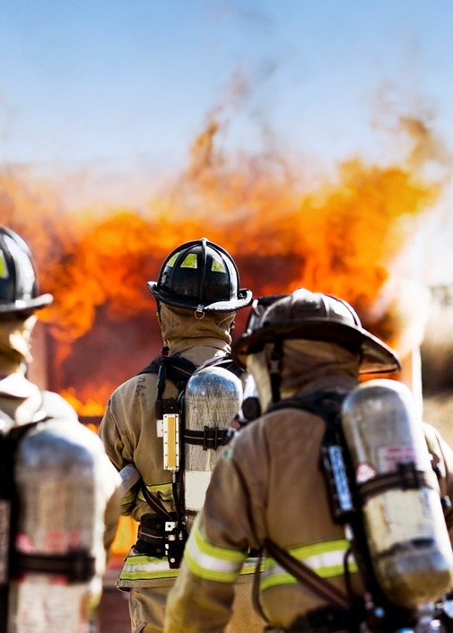
AFG Application Types
Operations and Safety
Vehicle Acquisition
Regional (Operations and Safety and Vehicle)
Notes:
The AFG Program consists of 3 separate applications.
The first is Operations and Safety that offers five activities: equipment, personal protective equipment, training, modifications to facilities, and wellness and fitness.
The second is Vehicle acquisition. Eligible applicants can request to replace unsafe vehicles in their fleet or add new vehicles.
The third is a Regional request where two or more departments combine their efforts to request mutually needed items. Important to note here is that all partners in the Regional application must be eligible recipients, so be an FD or NAEMS orgs.

Slide 16
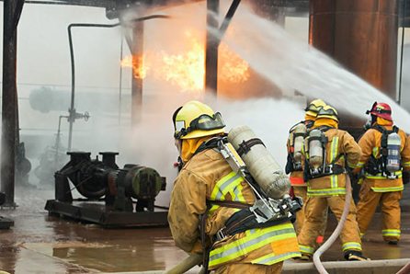
AFG Operations and Safety Application
Equipment
Personal Protective Equipment
Modification to Facilities
Wellness and Fitness Projects
Training
Notes:
As mentioned earlier, there are five activities to fall within the operations and safety part of the program. You will apply for these in the same application.
However, each activity requires its own narrative.
Each activity you see here has a specific list of eligible items that are funded. Sometimes eligibility or priority is based on applicant type (if it is a Fire Department or NAEMS) or community type (Urban, Suburban and Rural). Those specifics will be listed in the NOFO, so it is VERY important to review it before applying.

Slide 17
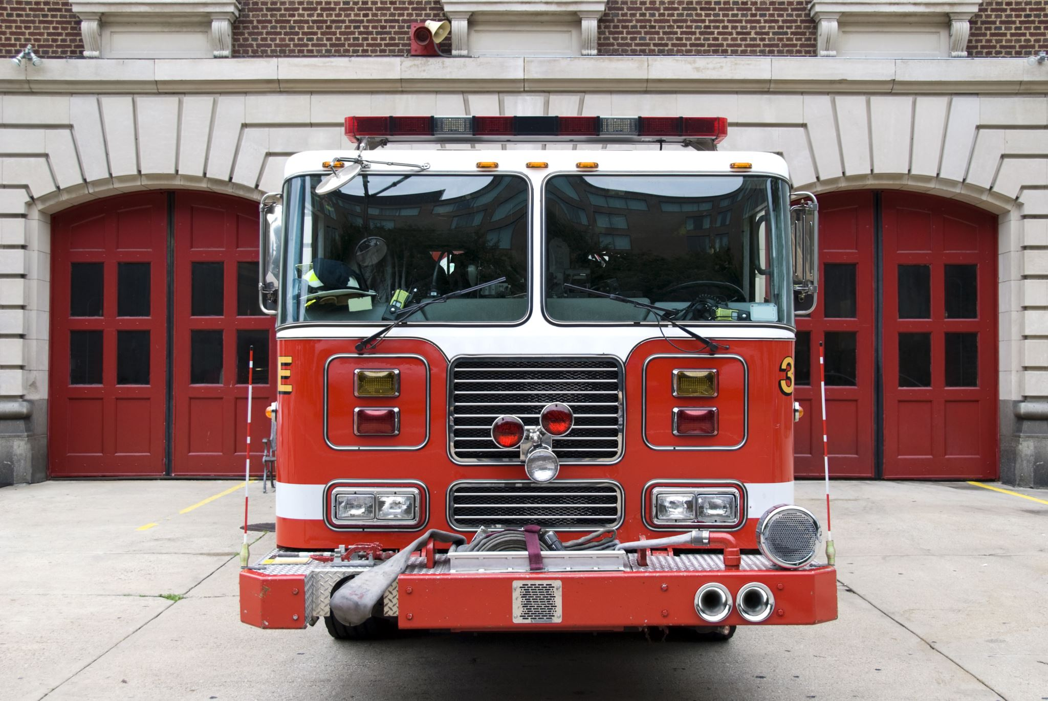
AFG Vehicle Acquisition Application
Replacement of Unsafe Vehicles
  Converted Tankers and Brush Trucks
  Vehicles Manufactured Prior to 1992 (NFPA 1901)
Acquisition of New Vehicles
Notes:
The high priority for vehicles is the replacement of unsafe vehicles (concerted vehicles from something that was not intended to serve that role.
or vehicles that were not manufactured to 1901 standard)
A list of specific vehicles that are funded under the program will be in the NOFO.

Slide 18
AFG Regional Applications
A Regional application is one in which multiple organizations serving more than one local jurisdiction benefit directly from the activities implemented with the grant funds.
Eligible projects:
  Operations and Safety (Training, Equipment, PPE, Wellness and Fitness)
  Vehicle Acquisition
Notes:
A regional request is where one or more agencies combine their efforts to request a commonly needed item or training.
Regional projects can be in the areas of training, equipment, PPE, or Wellness and fitness.
Two or more departments may also request to replace or acquire a vehicle that will benefit all departments involved. Regional applications have their own priority levels, so please make sure to review the NOFO.

Slide 19
AFG Fair Comparison Categories
Applicant Type
Community Type
Application Type
Activity Requested
Item Priority
Various Scoring Criteria
Notes:
Before we move to the SAFER program, I’d like to touch a little on how the applications are evaluated.
As you know all Fire Grants are competitive, meaning that funding will be allocated based on application that received highest scores and until we run out of money.
To make the scoring process as equitable as possible, under AFG, the applications are sorted by applicant type, community classification (rural, suburban and urban), application type (ops and safety or vehicle or regional), by activity requested (PPE or Equipment or Wellness and Fitness, etc.), then applications are sorted by specific items requested in each Activity, and then pre-scores are assigned based on the priority of the requested item and various scoring criteria.
This ensures that like departments compete with like departments within specific categories.
This concludes the AFG portion of the presentation, thank you.

Slide 20
Staffing for Adequate Fire and
Emergency Response (SAFER) Program
Notes:
This section of the presentation will focus on the AFG program.

Slide 21
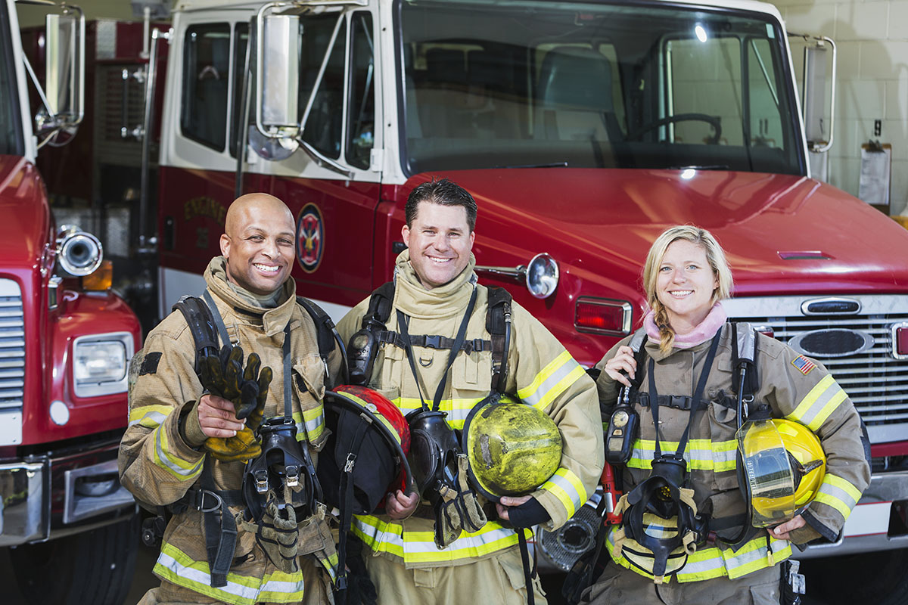
The objective of the SAFER Program is to assist local fire departments with staffing and deployment capabilities in order to respond to emergencies and assure that communities have adequate protection from fire and fire-related hazards.
Local fire departments accomplish this by improving staffing and deployment capabilities, so they may more effectively and safely respond to emergencies.
With enhanced staffing levels, recipients should experience a reduction in response times and an increase in the number of trained personnel assembled at the incident scene.

Slide 22
SAFER Priorities
FEMA prioritizes using grant funds to bring fire departments into compliance with National Fire Protection Association (NFPA) 1710 or 1720 standards in the most cost-effective manner.
Applications resulting in the largest percentage increases in compliance with NFPA 1710 or 1720 standards receive higher consideration.
  NFPA 1710 Assembly Requirements (Section 5.2.4.1 – Single-Family Dwelling
  Initial Full Alarm Assignment Capability).
  NFPA 1720 Assembly Requirements (Section 4.3 – Staffing and Deployment).
See SAFER Program NOFO for more information.

Slide 23
SAFER Activities
The SAFER Program is composed of two activities:
Hiring of Firefighters Activity (Hiring Activity) | Recruitment and Retention (R&R) of Volunteer Firefighters Activity
Career, combination, and volunteer fire departments are eligible to apply Interest organizations are not eligible to apply | Combination fire departments; volunteer fire departments; and national, state, local, or federally recognized tribal organizations that represent the interests of volunteer firefighters are eligible to apply Career fire departments are not eligible to apply
Applicants who wish to apply for both activities must submit two separate applications.

Slide 24
SAFER Hiring Activity
FEMA awards SAFER Program grants under the Hiring Activity to help fire departments increase the number of frontline firefighters by providing financial assistance in three categories:
  Rehire: Rehiring firefighters who were laid-off within the two years prior to the start of the application period
  Retention: Retaining firefighters facing imminent layoff – within 120 days of the close of the application period
  New Hire: Hire new, additional firefighters
The period of performance (POP) is 36 months for all grants awarded under the Hiring Activity.

Slide 25
SAFER Hiring Activity Eligible Costs
Salary and associated benefits (actual payroll expenses) for the positions funded under the SAFER Program are eligible.
Costs are reimbursable if they are included as part of the standard benefit package, available to all operational firefighter positions, contractually obligated, and reimbursed via payroll.
Compensation for a firefighter’s normal, contracted work schedule is reimbursable.
Notes:
Only costs for overtime that the fire department routinely pays as a part of the base salary or a firefighter’s regularly scheduled and contracted shift hours, in order to comply with the Fair Labor Standards Act (FLSA), are eligible.

Slide 26
SAFER Hiring Application Scoring
SAFER Program hiring applications are reviewed through a multi-phase process.
Phases | 1 – Pre-Score | 2 – Panel Review
 | Electronic pre-score process for all complete and eligible applications. Answers to activity-specific questions and the information in the department characteristic’s section of the application will determine an application’s standing relative to stated priorities. Once the standing to the SAFER Program priorities are established, each application will then receive a computer-generated score called the pre-score. | Panel of peer reviewers scores the narrative statement and makes funding recommendations.
Scoring Weight | 50% of total score | 50% of total score

Slide 27
SAFER R&R Activity
The R&R Activity assists fire departments with the recruitment and retention of volunteer firefighters who are involved with or trained in the operations of firefighting and emergency response.
Activities and costs must be correlated to the identified recruitment or retention needs identified in the application.
The POP may either be 12, 24, 36, or 48 months for grants awarded under the R&R Activity.

Slide 28
SAFER R&R Activity Regional Requests
Applicants may apply for a regional grant if the proposed activities will have a direct regional or local benefit beyond the immediate boundaries of the applicant’s first-due area.
A regional request is an opportunity for an eligible R&R Activity organization to act as a host and apply for funding on behalf of itself and any number of other participating R&R Activity-eligible organizations.
Regional host applicants and participating partner agencies must execute a Memorandum of Understanding (MOU).

Slide 29
SAFER R&R Activity Application Scoring
SAFER Program R&R applications are reviewed through a multi-phase process.
Phases | 1 – Pre-Score | 2 – Panel Review
 | Electronic pre-score process for all complete and eligible applications. Answers to activity-specific questions and the information in the department characteristic’s section of the application will determine an application’s standing relative to stated priorities. Once the standing to the SAFER Program priorities are established, each application will then receive a computer-generated score called the pre-score. | Panel of peer reviewers scores the narrative statement and makes funding recommendations.
Scoring Weight | 30% of total score | 70% of total score

Slide 30
Fire Prevention and Safety (FP&S) Program
Notes:
This section of the presentation will focus on the AFG program.

Slide 31
The FP&S Program is comprised of two activities:
Fire Prevention and Safety (FP&S) Activity
Designed to reach high-risk target groups and mitigate the incidence of death and injuries caused by fire and fire-related hazards
Research and Development (R&D) Activity
Aimed at improving firefighter safety, health, or well-being through research and development that reduces firefighter fatalities and injuries.
Notes:
Applicants who wish to apply for both activities must submit two separate applications
The total amount of funding a recipient may receive under an FP&S Program award is limited to a maximum federal share of $1.5 million.

Slide 32
FP&S Activity
Eligible Entities
  Fire departments
  National, regional, state, local, tribal and non-profit organizations that are recognized for their experience and expertise in fire prevention and safety programs and activities
  Both private and public non-profit organizations
  For-profit organizations, federal agencies, and individuals are not eligible
Period of Performance (POP)
  The POP is generally 12 months but complex projects may apply for up to a 24-month POP from the date of award.

Slide 33
FP&S Activity Categories
The five project categories eligible for funding under the FP&S Activity are:
Community Risk Reduction
Wildfire Risk Reduction
Code Enforcement/Awareness
Fire & Arson Investigation
National/State/Regional Programs and Projects

Slide 34
FP&S Activity Project Scoring
No computer pre-score
All FP&S Activity applications are reviewed by a panel of three peer reviewers
The highest scoring project(s) in each application will be considered within the fundable range
Approximately 75% of funds are allocated to national-level projects
FEMA will conduct a technical review of the highest-scoring projects to assess the request with respect to costs, quantities, feasibility, eligibility, and recipient responsibility

Slide 35
FP&S R&D Activity
Eligible Entities
  National, state, local, federally-recognized tribal, and non-profit organizations, such as academic (e.g., universities), research foundations, public safety institutions, public health, occupational health, and injury prevention institutions
  Both public and private non-profit organizations are eligible to apply for funding in the R&D Activity
Period of Performance
  The period of performance for projects proposed under the R&D Activity may be 12, 24, or 36, or 48 months from the date of award.

Slide 36
FP&S R&D Activity - Categories
The five project categories eligible for funding under the R&D Activity are:
Clinical Studies
Technology and Product Development
Database System Development
Preliminary Studies
Early Career Investigator

Slide 37
FP&S R&D Activity Project Scoring
No computer pre-score
All R&D Activity applications are reviewed first by a fire service panel (relevance review)
The highest scoring projects (about 1/3rd of all submissions) then move to the science panel review
FEMA will conduct a technical review of the highest-scoring projects to assess the request with respect to costs, quantities, feasibility, eligibility, and recipient responsibility

Slide 38

Newsletter Sign-Up
https://public.govdelivery.com/accounts/USDHSFEMA/subscriber/new?topic_id=USDHSFEMA_153
Notes:
We send monthly newsletters and various reminders and notifications. if you are not receiving one already, please sign up.

Slide 39
Fire Grant Programs Website: https://www.fema.gov/firegrants
Fire Grant Programs Help Desk
  Monday through Friday, 8:00 AM – 4:30 PM ET
  1-866-274-0960
  FireGrants@fema.dhs.gov
Notes:
Thank you for attending this presentation. We are happy to answer any questions you may have right now.
All documents that we mentioned during this presentation are available at our website including our webinar schedules.
For any questions you can always reach out to our Help Desk.

